Slide 1

Chemistry Paper - VII (Inorganic Chemistry)
B.Sc - II
4. Chemistry of Elements of 3d - series elements

Slide 2
Position of elements in periodic table -
d-block elements -
Definition -
Elements having partially filled d-sub shell of (n-1) main shell in their atomic state or in common oxidation state
d-block elements are also called as transition elements
d-block elements observed between s-block & p-block elements

Slide 3
Properties intermediate between s & p-block elements
d-block elements are placed between groups
3 -12 in periodic table
First transition series -
As last electron enters the 3d - orbital
Hence first transition is also called 3d-block elements or 3d series.
It includes 10 elements
Scandium, titanium, vanadium, chromium, manganese, iron, cobalt, nickel, copper, zinc

Slide 4
General Characteristics -
1. High M. P. & B. P. , high density, high tensile strength, malleability, ductility, high thermal & electrical conductivity, metallic Luster
2. Act as catalyst, catalyse number of reactions
3. Have high heat of vapourization
4. Form alloys (alloy means homogenous mixture of 2 or more metals)
5. Form interstitial compounds with non-metals like C, B, N.

Slide 5
6. Most of them form coloured compounds
7. Form stable complexes
8. Almost all of them are paramagnetic
9. Shows various oxidation states

Slide 6
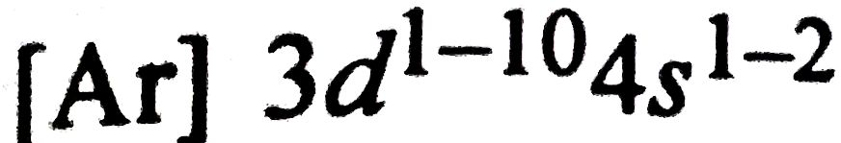
Electronic Structure -
General electronic configuration for these elements can be written as -
Electrons filled in orbitals - according to Hund's rule, Pauli's exclusion principle, Aufbau principle & spectroscopic evidences
Incoming electrons are added in 3d-sub energy levels

Slide 7
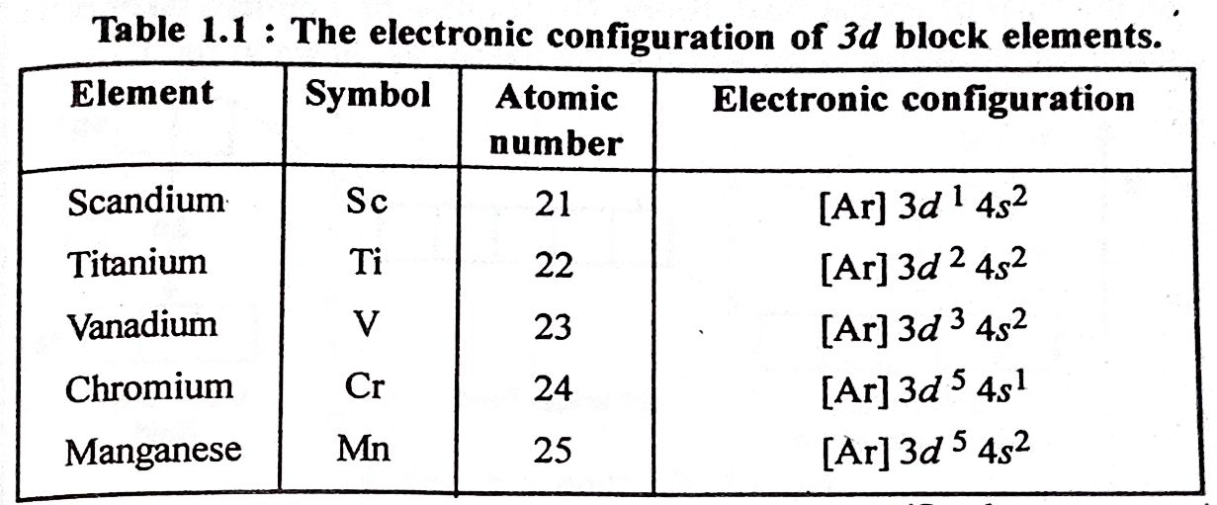
First fill 4s-orbital, then fill 3d- orbital by electrons
Because last electron filled in 3d - sub shell (orbital) means 3d - block element.

Slide 8
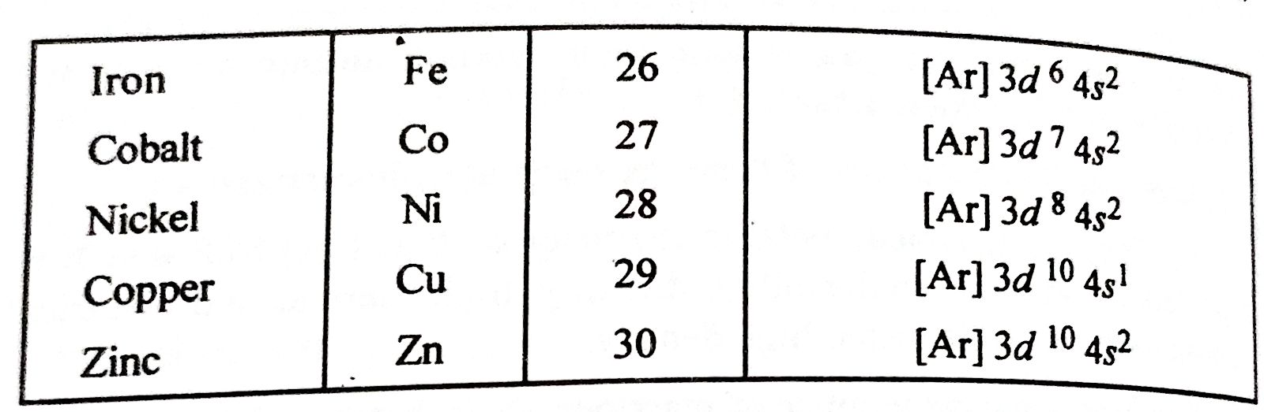
In some cases 4s-orbital shows 1 electron
e.g. Chromium, copper
This is due to special stabilities associated with half filled & completely filled sub energy levels

Slide 9
Electronic structures are stabilised by following factors as -
1. Nuclear electron attraction
2. Electron-electron Repulsion
3. Shielding of electrons of each other
4. Exchange of energy
5. Small difference of energy between 3d & 4s orbitals

Slide 10
Coloured Ions -
Colour of a substance is due absorption of radiation in visible region
Ionic & covalent compounds of 3d- block elements are coloured
These compounds show colour due to electronic transition in d - orbitals
Electronic transitions are of 2 types -
1. d-d transition
2. Charge transfer spectra

Slide 11


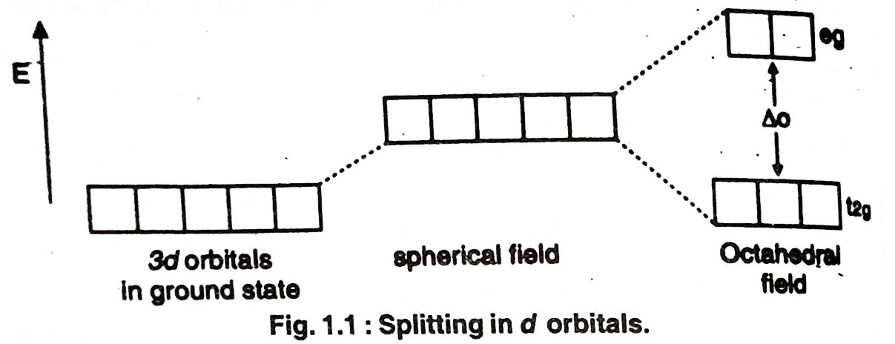
In d-d transition, electron is transferred from one d - orbital to other within 3d level
e.g.
Charge of titanium - 3+ i.e.
This is best way explained by crystal field theory. Splitting of d-orbitals under the influence of the surrounding ligands

Slide 12

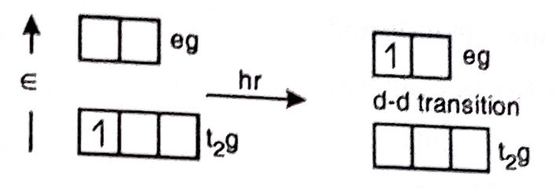
When sun light (white light) falls on
ion, it absorbs green radiation & one electron get excited from t2g to eg as -
Complementary colour of absorbed green radiation is purple.
Therefore appears purple coloured.
i.e. white light - absorbed light = transmitted light
Similarly colour of the hydrated ions of 3d block elements can be discussed as (below in table) -

Slide 13


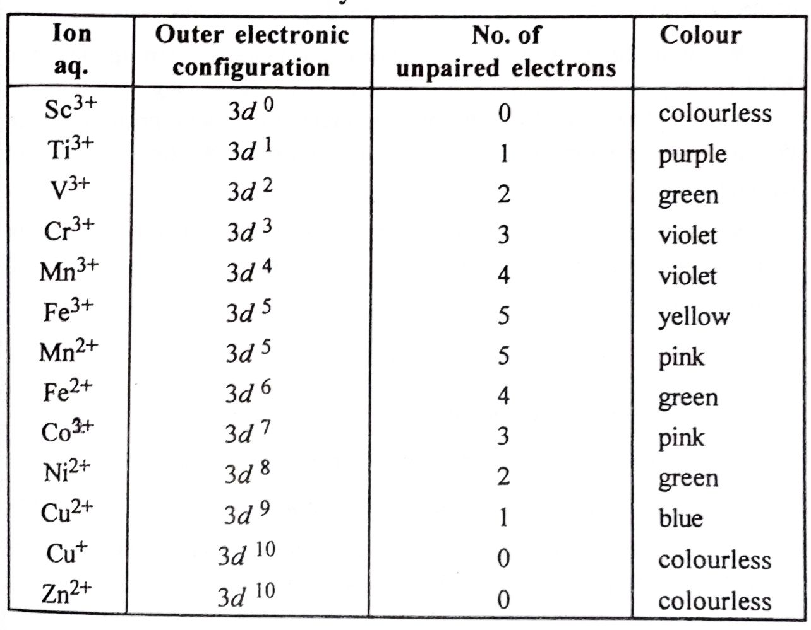
From the below table it is clear that &
cases are colourless.

Slide 14


Colour is associated with or
electrons due to d-d transition.
Charge transfer transition occurs when an electron is transferred from orbital of ligand to orbital of metal or vice versa.
d-d transitions give pale colours while charge transfer transitions give dark colour.

Slide 15

Factors affecting the colour of the complexes -
1. Number of 3d electrons
No. of d electrons
2. Field strength of ligand
3. Geometry of complex
4. Defects in solids

Slide 16
Magnetic Character -
Magnetic measurements are employed to detect the presence of unpaired electrons in substance & to determine its electronic structure.
On the basis of magnetic properties, substances are classified as -
1. Paramagnetic substances
2. Diamagnetic substances

Slide 17
1. Paramagnetic substances -
Definition -
Substances which are weakly attracted by the strong magnetic field which are parallel to the magnetic field are known as paramagnetic substances.
Such substances contain one or more unpaired electrons.
Unpaired electron acts as very small magnet.
2. Diamagnetic Substances -
Definition -

Slide 18
Substances which are weakly repelled by the strong magnetic field & align perpendicular to the magnetic field are known as diamagnetic substances.
Such substances contain all the paired electrons or no single or no unpaired electron.
Ferromagnetic substance -
Definition -
When the force of attractive between substance & strong magnetic field is very high, such substance is called as ferromagnetic substance.
e.g. Fe, Co, Ni

Slide 19

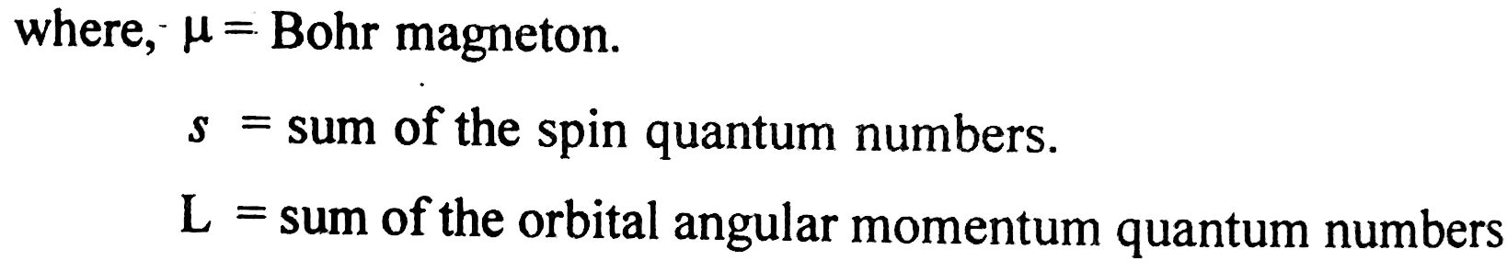
These compunds shows permanent magnetic property. They are removed from magnetic field, so they do not get magnetised.
Paramagnetism arises due to interaction of spin momentum & angular orbital momentum of unpaired electron. It can be determined by equation -

Slide 20
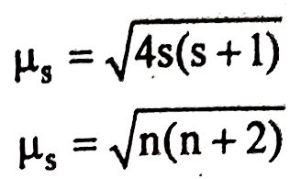
In many compounds of 3d block elements, orbital condition is quenched out by the electric fields of surrounding atoms.
The magnetic moment can be calculated by the equation as -
From spin quantum numbers
Where, n = number of unpaired electrons.
Using this equation magnetic moments are calculated as -

Slide 21
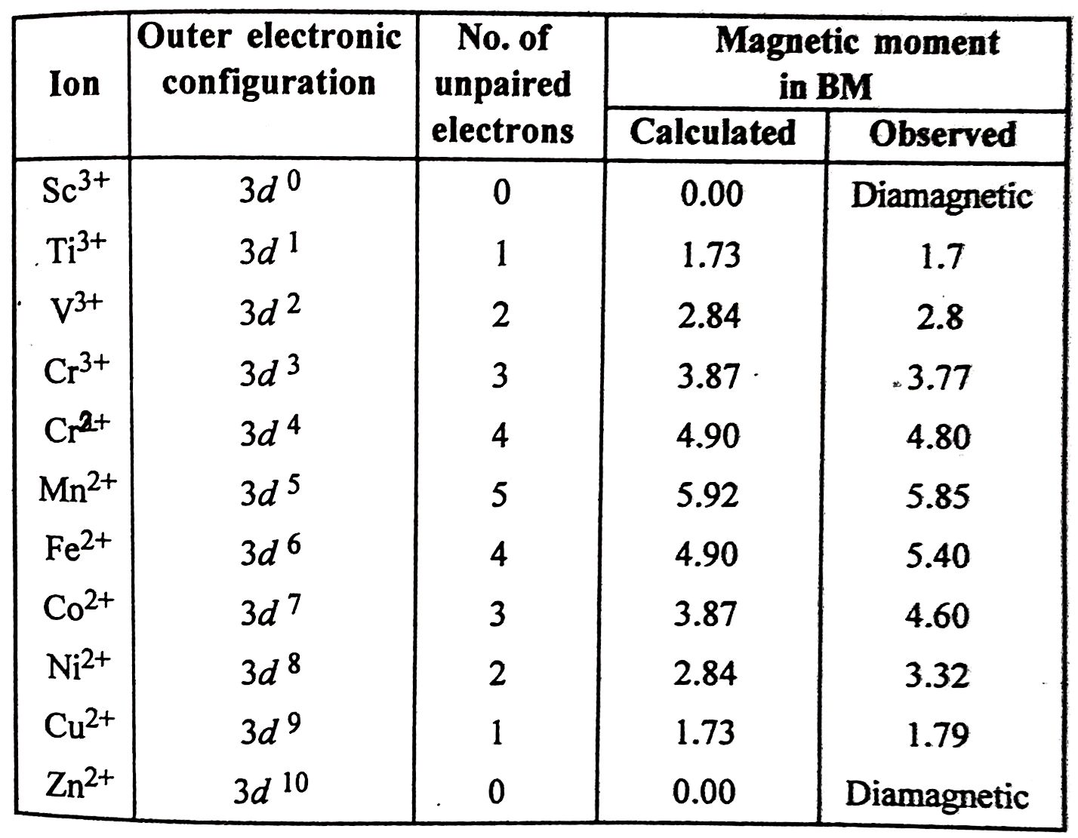

Slide 22
From this table, it is clear that increase in number of unpaired electrons, increases magnetic moment.
Both paramagnetism & diamagnetism are temperature dependent.

Slide 23
Oxidation States -
Definition -
The numberical charge present on the atom, ion or species is called as oxidation state.
3d block elements show variable oxidation States because energy difference between 4s & 3d orbitals is negligible.
The oxidation States of these elements are given below in the table as -

Slide 24
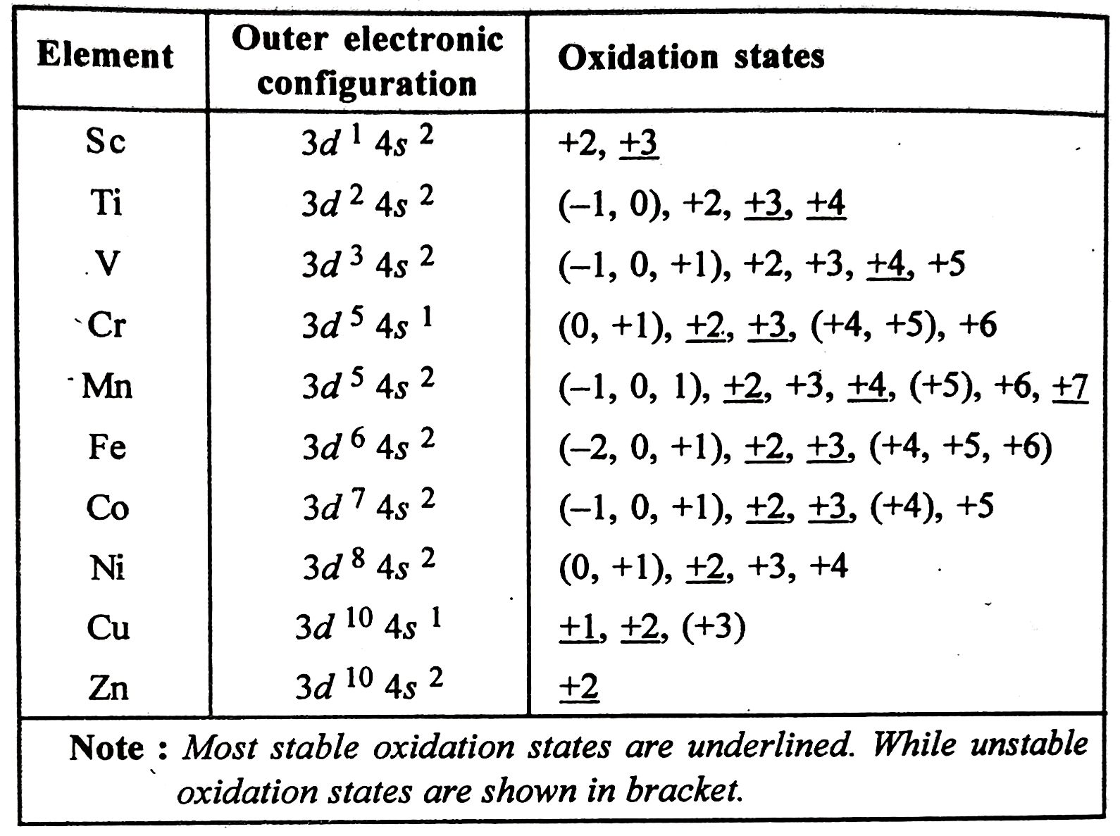

Slide 25

Significant Figures -
1. Minimum oxidation state is +1.
e.g. Cr (I), Cu (I)
2. Maximum oxidation state is +7.
e.g. Mn (VII)
3. Common oxidation state is +2.
4. Oxidation states increases from scandium to manganese & then decreases upto zinc with increase in atomic number.
5. Doubtful oxidation states are

Slide 26



Variety of oxidation states are formed by loss of electrons from 4s to 3d orbitals.
Relative stabilities -
Relative stabilities of various oxidation states are could be compared with extra stability of
configurations.
Hence is more stable than
Similarly relative stabilities of various oxidation states of these elements can be described as -
Lower oxidation states like -2, -1, 0, 1 are unstable. These oxidation states are stabilised by

Slide 27
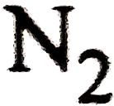
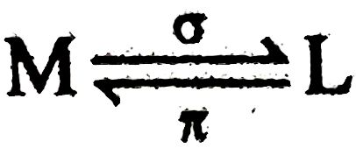

forming complexes with π acid ligands like
, etc.
The bond between metal & ligand represented as -
Unstable higher oxidation states are stabilised by forming complexes with small, highly electronegative ligands like etc.
Stability of +2 oxidation state increases from Sc to Zn while +3 oxidation state decreases from Sc to Cu.

Slide 28
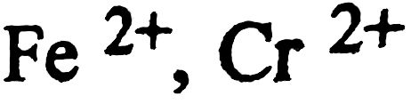
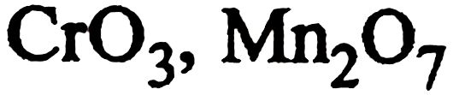
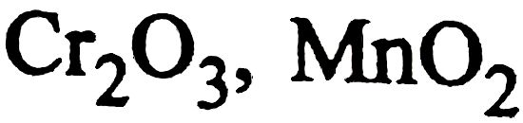
Nature of compounds in different oxidation states -
1. In lower oxidation states such as 2+, compounds act as reducing agents & are basic
e.g.
2. In higher oxidation states like 6+, 7+, compounds act as oxidising agents & are acidic.
e.g.
3. Compounds in 3+, 4+ oxidation states are amphoteric. (acts as both acidic & basic)
e.g.

Slide 29
4. Compounds in higher oxidation states show more covalent (acidic) character.
Compounds in lower oxidation states show more ionic (basic) character.
This is in accordance with fajan's rule.

Slide 30
Complex Formation -
Nature of 3d block elements is to form stable complexes with variety of ligands. It is possible because of -
1. Small size
2. High effective nuclear charge
3. High positive charge density
4. Availability of vacant orbitals with appropriate energy to accept electron pairs donated by ligands
5. Ability to form Sigma as well as pi bonds
6. Weak electropositive character

Slide 31
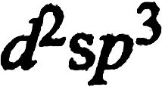
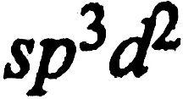
Octahedral Inner & Outer Orbital Complexes -
Six coordinated complexes show hybridisation either or .
According to Pauling when inner i.e. (n - 1) d orbitals are used, then the hybridisation is called as
hybridisation & the complex formed is called as octahedral inner orbital complex.
According to Pauling when outer i.e. nd orbitals are used, then the hybridisation is called as
hybridisation & the complex formed is called as octahedral outer orbital complex.
For examples -

Slide 32
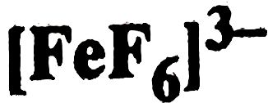
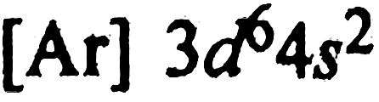
Formation of - Hexafluoro ferrate (III) ion
The electronic configuration of iron is -
The oxidation state of iron is 3+ (by lossing 3 electrons)
Ligands, F are poor electron donor or weak ligands
Ligands have poor overlap with metal orbitals
Complex shows hybridisation

Slide 33
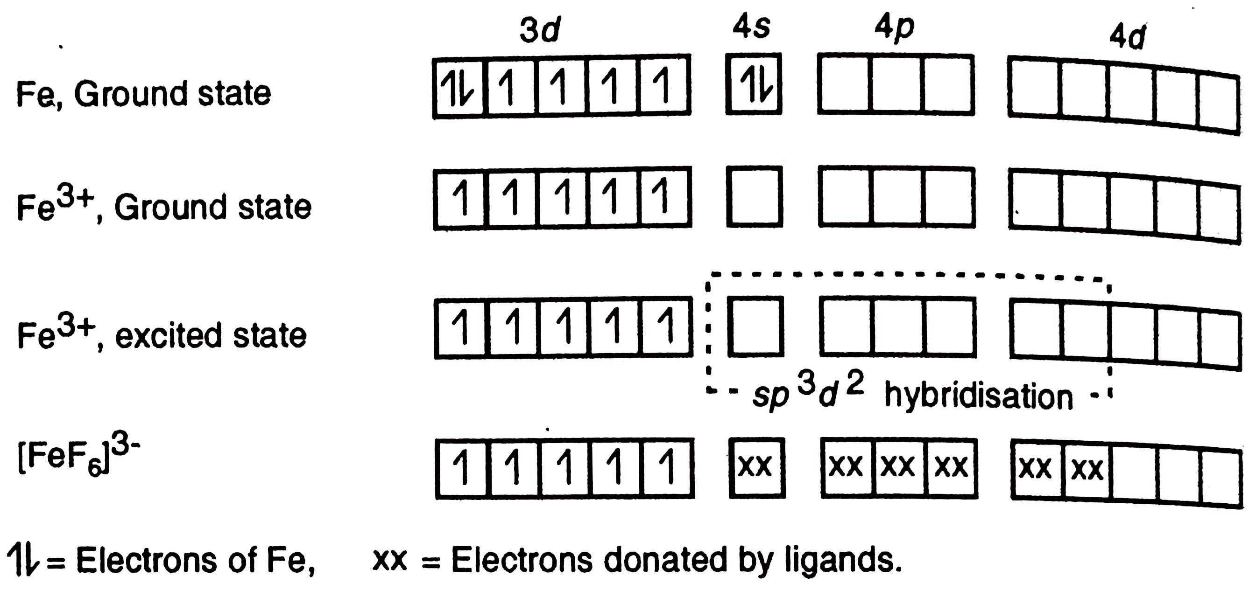
Geometry is octahedral & complex is octahedral outer orbital complex (Huggin) (ionic or latrile or hyper ligated by Pauling)
Paramagnetic complex due to 5 unpaired electrons

Slide 34
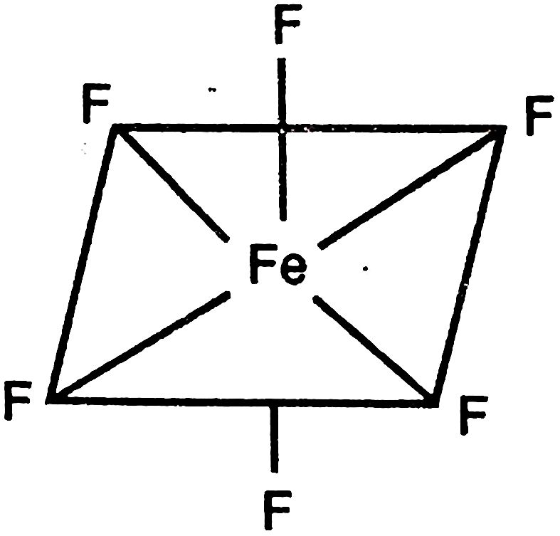
Complex shows high paramagnetism
Due to large unpaired electrons, complex called high spin or spin free complex.
Fig. Octahedral ion

Slide 35
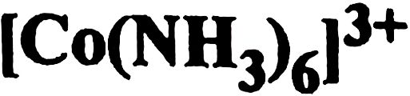
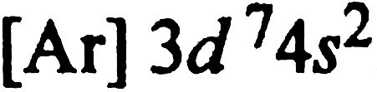
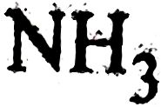
Formation of - Hexa ammino Cobalt (III) ion
The electronic configuration of cobalt is -
The oxidation state of iron is 3+ ( by lossing 3 electrons)
Ligands, are strong ligands. They pair all the electrons inside.
Hence complex shows hybridisation

Slide 36
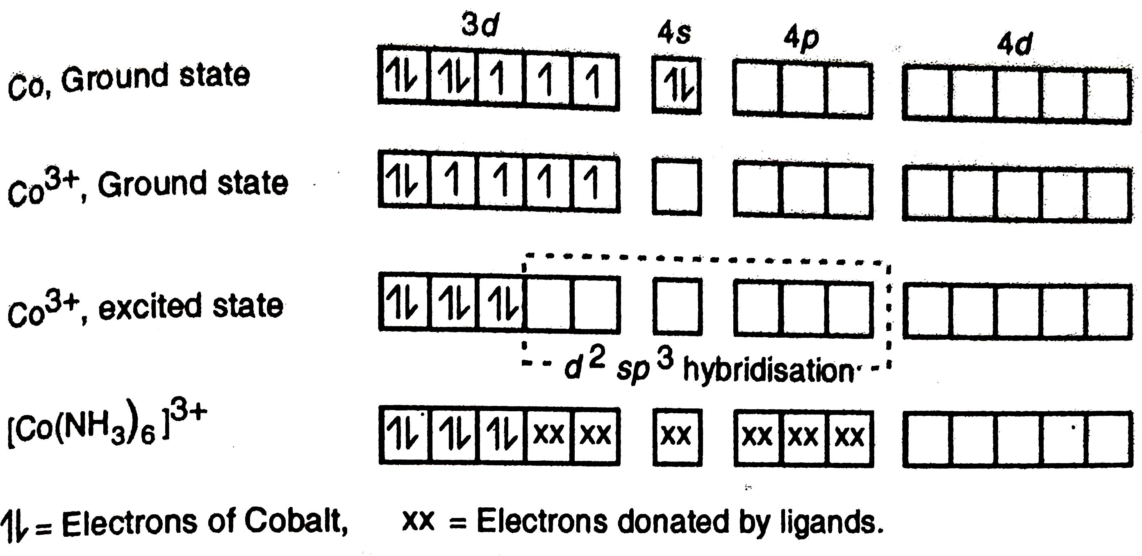
Geometry is octahedral & complex is octahedral inner orbital complex (Huggin) (covalent or inert or hypoligated by Pauling)
Diamagnetic due to all paired electrons or absence of unpaired electrons

Slide 37
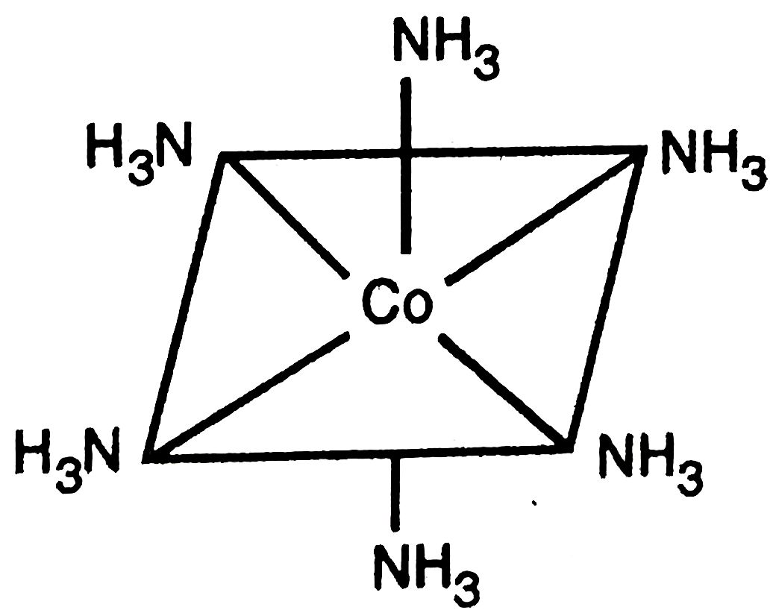
Due to paired electrons, complex called low spin or spin paired complex.
Fig. Octahedral ion

Slide 38
Geometry of Complexes -
Geometry of complexes depends on coordination number & type of hybridisation.
Complexes have linear, square planar, tetrahedral, octahedral structure.
Stability of Complexes -
The stability of complex depends upon nature of ligands, also because pi bonding tendency of ligands increases the stability.

Slide 39
Trends in first transition series for complex formation -
1. The stability of complexes increases with increase in atomic number within the series as atomic size decreases.
2. 3d block elements exhibit more than one oxidation states. Therefore higher valent cations are able to form more stable complexes.

Slide 40
Thank You

