Slide 1
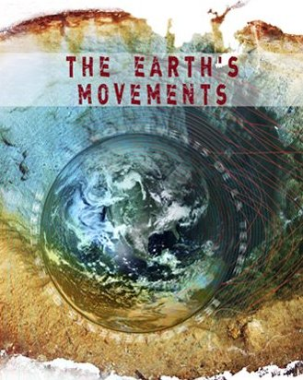
Ádj.k & 3
Hkw&gkypkyh
(Earth Movements)

Slide 2
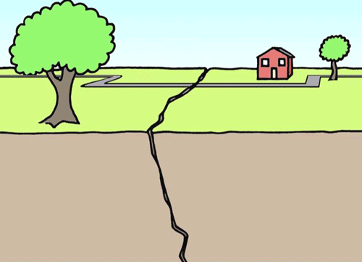
Hkw&gkypkyh
(Earth Movements)
i`FohP;k Hkwdopkr cny ?kMowu vk.k.kkÚ;k ‘kDrhaukp ^Hkw gkypkyh* vls Eg.krkr-

Slide 3
Hkw&gkypkyhaps izdkj
Hkwgkypkyh
varxZr 'kDrh
cfgxZr 'kDrh
mu] okjk] ikÅl] unh] b- ckádkjdkaps dk;Z
ean gkypkyh
'kh?kz gkypkyh
Hkwdai
Tokykeq[kh
m/oZ gkypkyh
vkMO;k gkypkyh
[kuu
vi{k;@{kj.k
fonkj.k
eSnkus] iBkjs
lkxj fdukjs
oyhdj.k
ÁLrjHkax

Slide 4
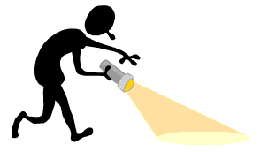
Hkw&gkypkyhaps izdkj
Hkwgkypkyh
varxZr 'kDrh
cfgxZr 'kDrh
mu] okjk] ikÅl] unh] b- ckádkjdkaps dk;Z
ean gkypkyh
'kh?kz gkypkyh
Hkwdai
Tokykeq[kh
m/oZ gkypkyh
vkMO;k gkypkyh
[kuu
vi{k;@{kj.k
fonkj.k
eSnkus] iBkjs
lkxj fdukjs
oyhdj.k
ÁLrjHkax

Slide 5
varxZr gkypkyh
1- ean gkypkyh (Slow Movements)
v½ m/oZ gkypkyh (Epeirogenic Movements)
i`FohP;k varxZr Hkkxkr mH;k fn’ksr] [kkywu oj dk;Z dj.kkÚ;k
ean gkypkyhauk ^m/oZ gkypkyh* Eg.krkr-
ioZr] iBkjs] eSnkus] leqæ fdukjs ;klkj[kh Hkwfe[kaMs r;kj
^Hkw[kaM fuekZ.kdkjh gkypkyh*
m/oZ gkypkyhaps ifj.kke
eSnkus &jf’k;k o mRrj vesfjdsrhy eSnkus
iBkjs & Hkkjrkrhy n[[kups iBkj o nf{k.k vkfÝdsps iBkj
leqæ fdukjs & fj;k fdukjk] fQ;kWMZ fdukjk] Mkyesf’k;u fdukjk] b-

Slide 6
c½ vkMO;k gkypkyh (Orogenic Movements)
Hkwdopkr ean xfrus dk;Z dj.kkÚ;k gkypkyh tsaOgk vkMO;k fdaok f{kfrt lekarj fn’ksus dk;Z djrkr rsaOgk R;k gkypkyhauk ^vkMO;k* fdaok ^f{kfrt lekarj gkypkyh* Eg.krkr-
ioZrkaph fufeZrh
^ioZr fuekZ.kdkjh gkypkyh*
vkMO;k gkypkyhaps ifj.kke
oyhdj.k
ÁLrjHkax

Slide 7
v½ oyhdj.k (Folding)
HkwvarxZr ean gkypkyh vkMO;k fn’ksr dk;Z djhr vlrkuk HkwdopkP;k e`nw Hkkxkl ?kMÓk fdaok oGÓk iMrkr- ;k fØ;syk ^oyhdj.k* vls Eg.krkr
Hkwi`"Bkl ?kMÓk iMY;kuarj Hkwdopkpk dkgh Hkkx oj mapkoyk tkrks R;k Hkkxkl ^foeq[kurh* fdaok ^viurh* (Anticline) Eg.krkr-
rj nksu ?kMhP;k njE;kuP;k [kksyxV Hkkxkl ^laeq[kurh* fdaok ^vfHkurh* (Syncline) vls Eg.krkr-

Slide 8
^foeq[kurh* fdaok ^viurh*
^laeq[kurh* fdaok ^vfHkurh*

Slide 9
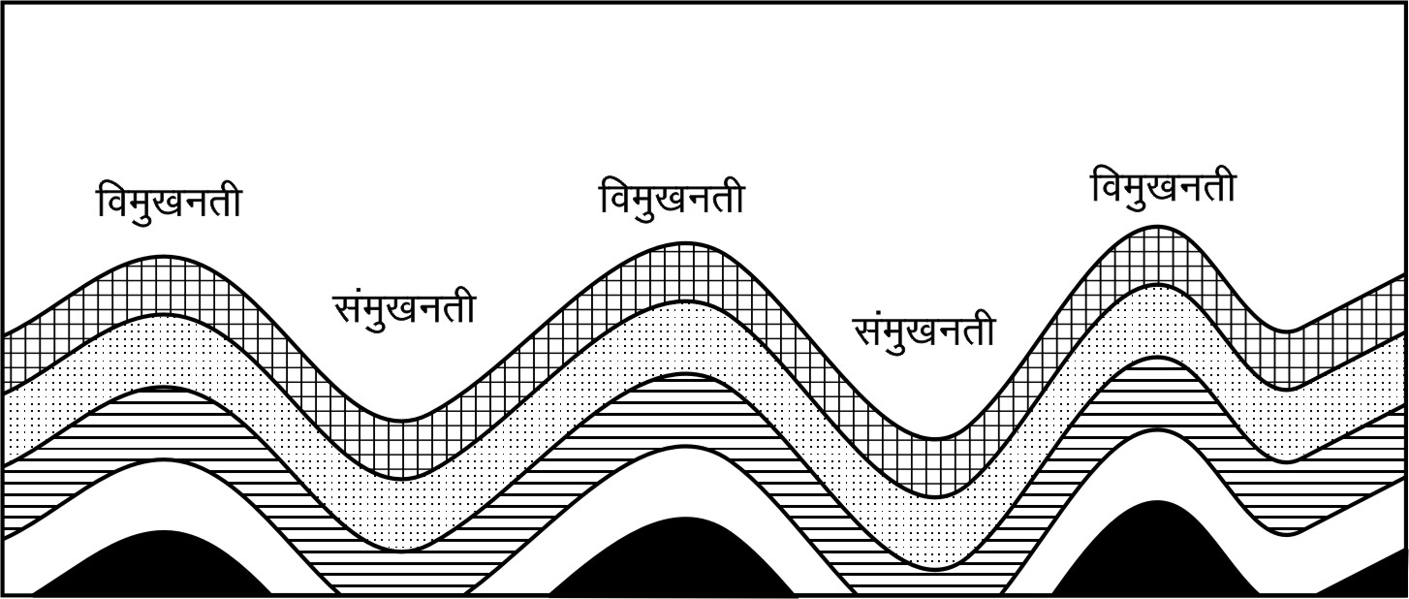
oyhdj.k
(Folding)

Slide 10
oGÓkaps Ádkj
nkc nksUgh cktwauh lkj[kkp
nksUgh cktw leku mrkjkP;k o leku ykachP;k

Slide 11
oGÓkaps Ádkj
nkckph rhozrk gh ,dk cktwus tkLr o nqlÚ;k cktwus deh
nkc deh vlrks rh cktw ean mrkjkph o tkLr ykachps vlrs-
nkc TkkLr vlrks rh cktw rhoz mrkjkph o deh ykachps vlrs-

Slide 12
oGÓkaps Ádkj
,dk cktwus deh nkc o nqlÚ;k cktwus vfrtkLr nkc iMr jkfgY;kl rh oGh nkLr nkckP;k cktwdMwu Hkwi`"BkdMs >qdyh tkrs-
nksUgh cktw lk/kkj.ki.ks ,desdkal lekarj vlrkr- rlsp nksUgh cktwpk mrkj ns[khy ,dkp cktwl vlrks-

Slide 13
oGÓkaps Ádkj
leur oGh frP;koj vk.k[kh nkc iMr xsY;kl rh oGh Hkwi`"Bkoj vkMoh iMrs-
;k oGhP;k nksUgh cktw Hkwi`"Bkyk lekarj vlrkr-

Slide 14
oGÓkaps Ádkj
ijhofyr oGhph fufeZrh >kY;koj frP;koj nkc iM.;kph fØ;k lrr pkyqp jkfgY;kl fdaok oGhP;k ojP;k cktwoj nkckph rhozrk ok<Y;kl R;k oGhpk vkl nqHkaxyk tkÅu rh oGh rqVrs-

Slide 15
oGÓkaps Ádkj
Hkwdopkoj iM.kkjk nkc gk rhoz Lo:ikpk vlsy o R;kp cjkscj Hkwdopkph jpuk e`nw [kMdkaph vlsy rj R;k Hkwdopkl ,dkosGh vusd oGÓk iMrkr-
dkykarjkus ;k oGÓk mapkoY;k tkÅu R;kauk ia[;klkj[kk vkdkj ÁkIr gksrks- Eg.kwu ;k oGÓkauk ^ia[kkÑrh oGÓk* Eg.krkr-

Slide 16
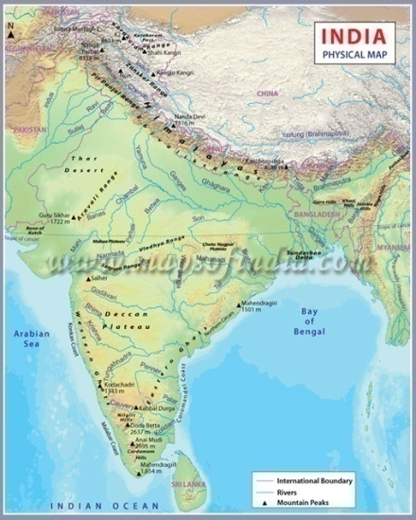
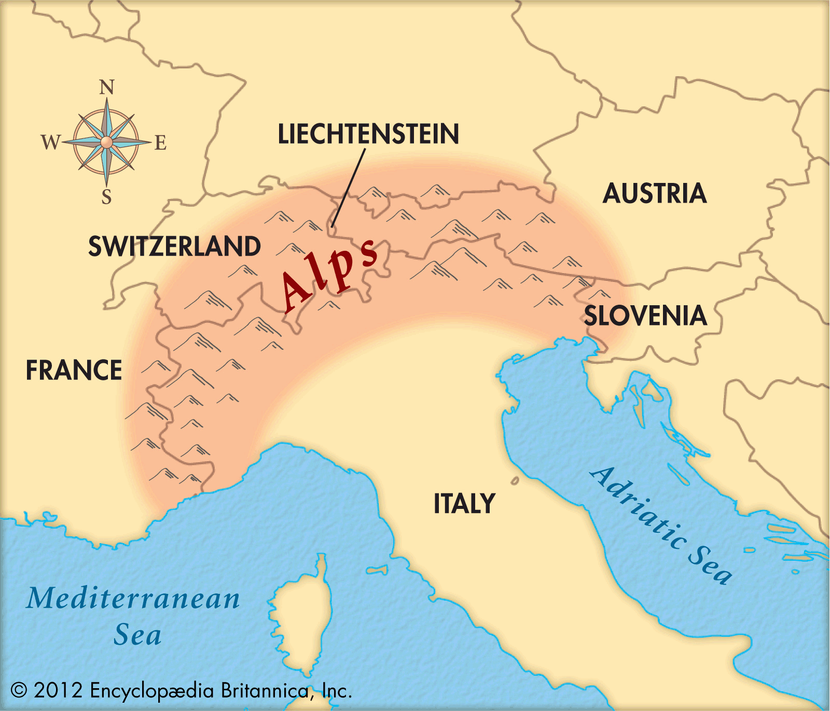
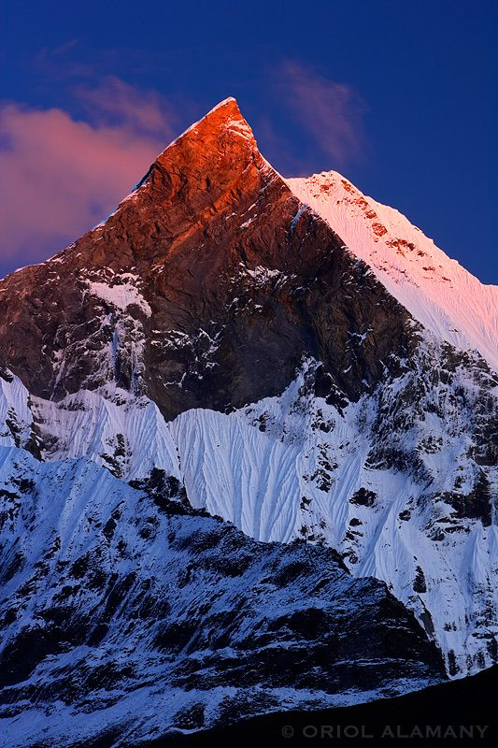
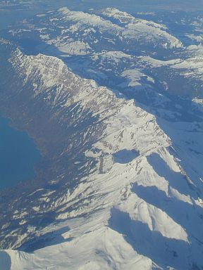
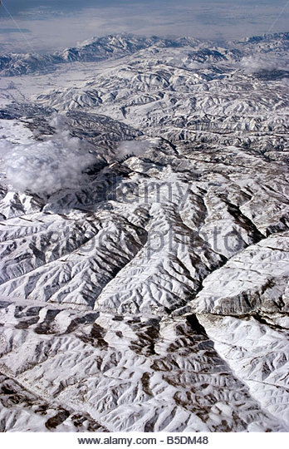
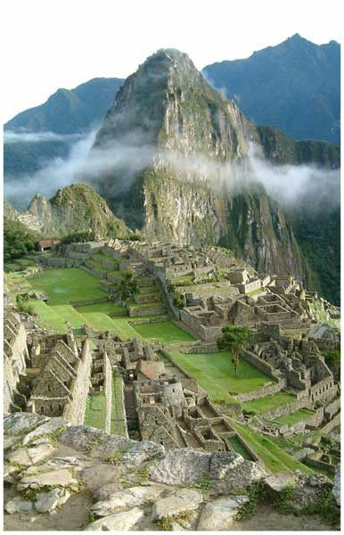
oyhdj.kkps ifj.kke %^oyh ioZr* fdaok ^?kMh ioZr*

Slide 17
c½ ÁLrjHkax (Faulting)
f{kfrt lekarj vkMO;k gkypkyh tsaOgk dfB.k HkwdopkP;k Áns’kkr dk;Z djrkr- R;kosGh Hkwi`"Bkyk oGÓk u iMrk] Hkwi`"Bkyk Hksxk iMrkr fdaok rMs tkrkr] Hkwdop nqHkaxrs- ;k fØ;syk ^ÁLrjHkax* Eg.krkr-
ÁlrjHkaxkeqGs Hkwdopkpk HksxstoGhy Hkkx oj ljdrks fdaok [kkyh [kpyk tkrks-
oj ljdysY;k Hkkxkl ^m/oZ{ksfir Hkkx* (Up Thrown Side) Eg.krkr-
[kkyh [kpysY;k Hkkxkl ^v/k%{ksfir Hkkx* (Down Thrown Side) Eg.krkr-

Slide 18
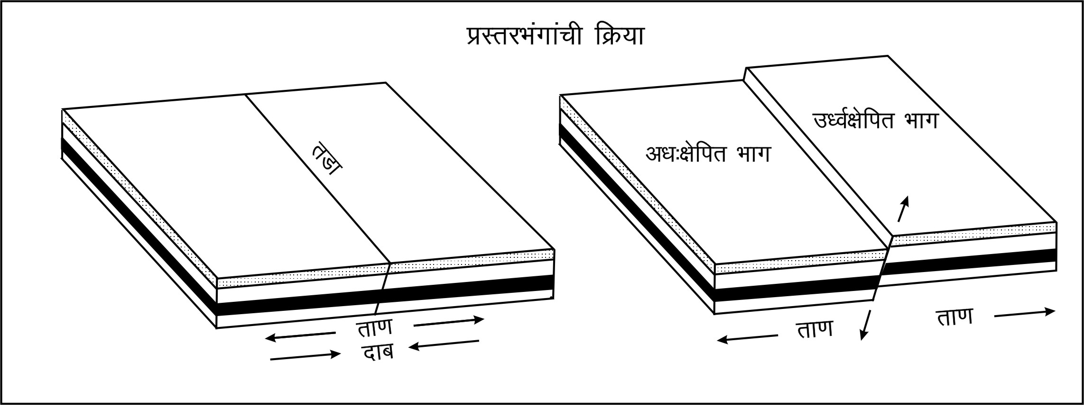

Slide 19
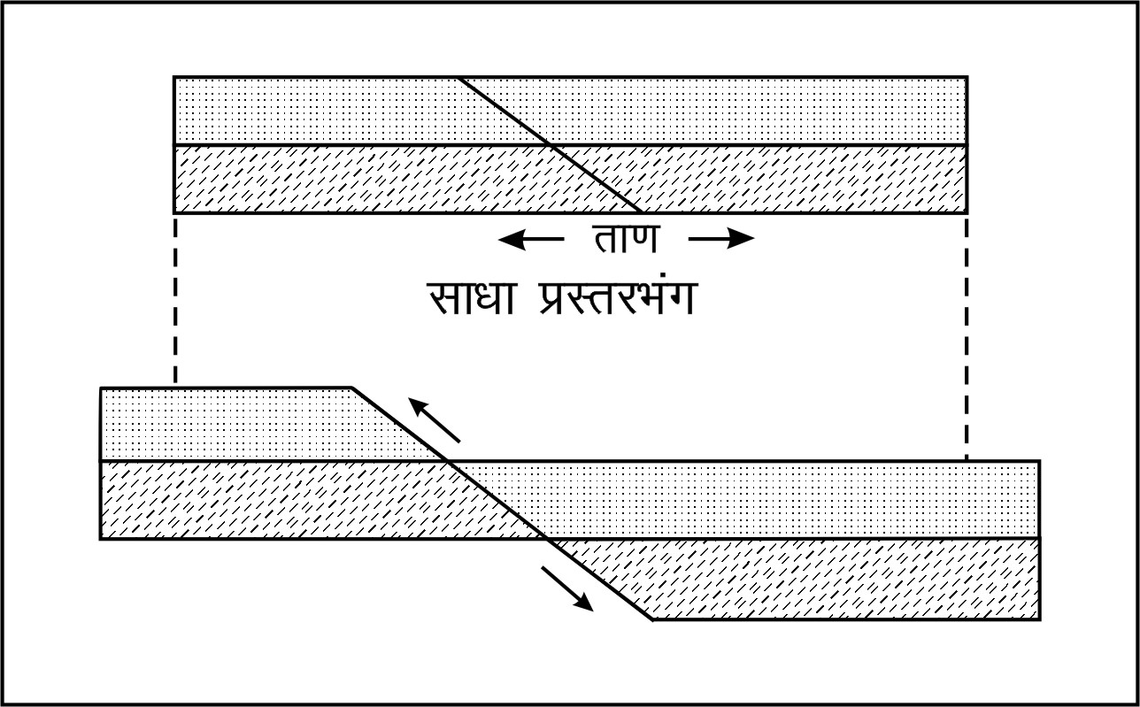
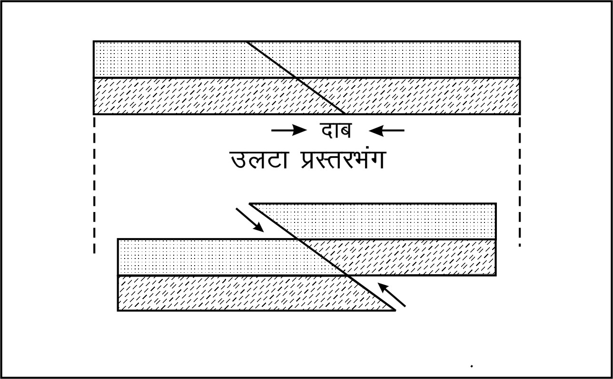
ÁLrjHkaxkps Ádkj
1-lk/kk ÁLrjHkax (Normal Fault)
2-myVk ÁLrjHkax (Reverse Fault)

Slide 20
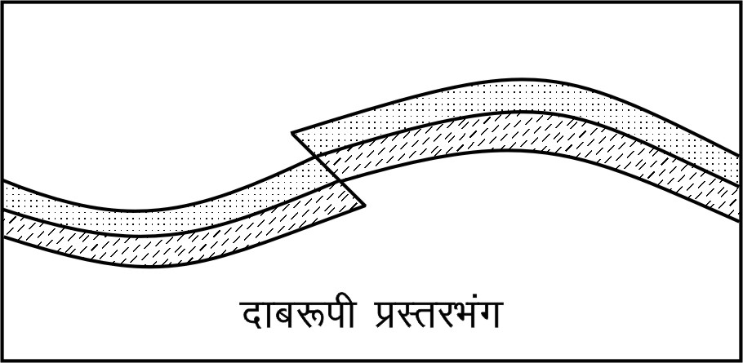
3- nkc:ih ÁLrjHkax (Thrust Fault)

Slide 21
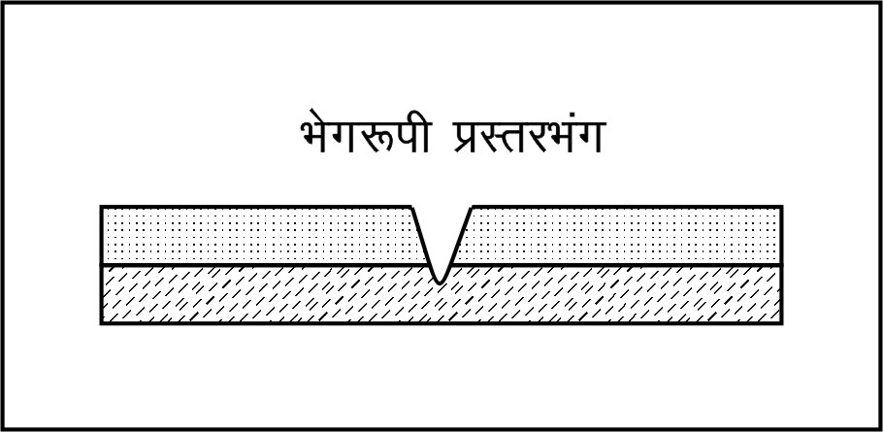
4- Hksx:ih ÁLrjHkax (Tear Fault)

Slide 22
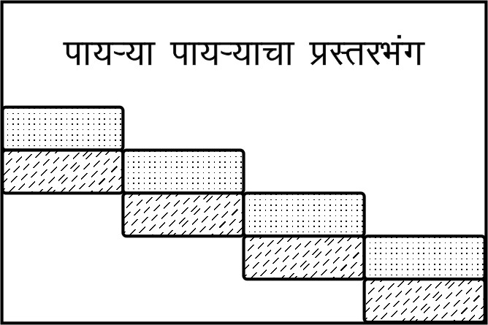
5- ik;Ú;k ik;Ú;kpk ÁLrjHkax (Terrace Fault)

Slide 23
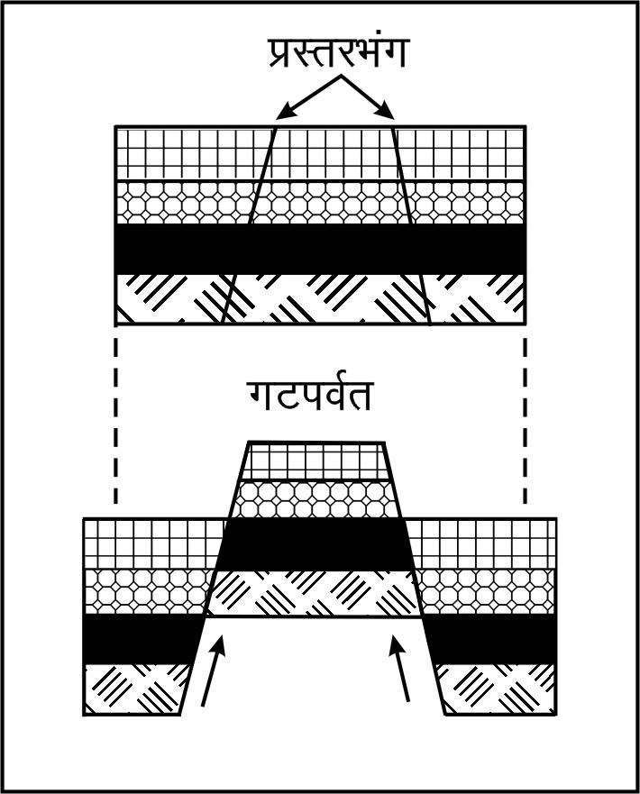
ÁLrjHkaxkps ifj.kke
xV ioZr (Block Mountain)
^BksdGÓkps ioZr*
teZuhrhy gkWtZ
dWfyQksfuZ;krhy fl,jk usokMk
ÝkUle/khy fczVkuh

Slide 24
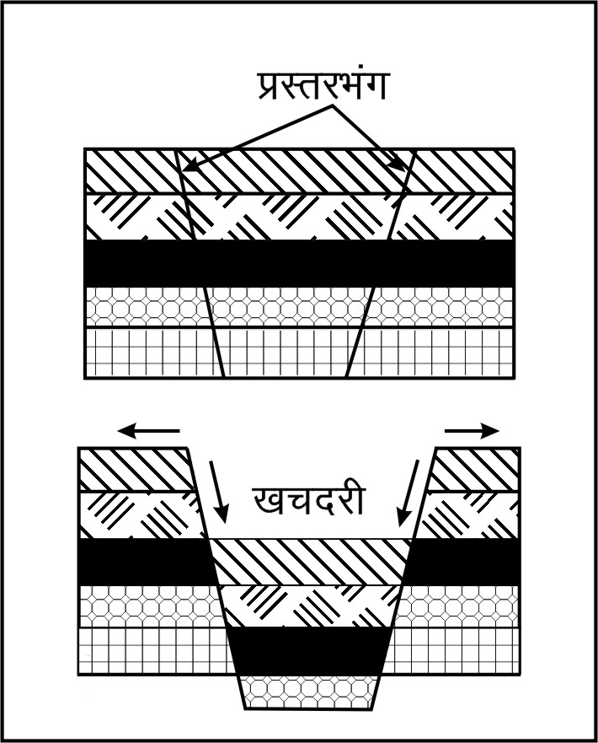
[kp njh (Rift Valley)
^ikVnjh*
;qjksikrhy ÚgkbZu unhph njh
iwoZ vkfÝdsrhy njh
Hkkjrkrhy ueZnk o rkih unhP;k [kksÚ;kr
v’kk [kpnÚ;k vk<Grkr-

Slide 25
2- ‘kh?kz gkypkyh (Sudden Movements)
HkwvarxZr Hkkxkr vR;ar tynxrhus dk;Z dj.kkÚ;k gkypkyh
Hkwdopkr vpkudi.ks cny ?kMowu vk.krkr
fo/oald Lo:ikP;k vlrkr
Tokykeq[kh
Hkwdai

Slide 26
v½ Tokykeq[kh (Volcanoes)
HkwxHkkZrhy rIr f’kykjl T;k fBdk.kh Hkwdop dedqor vlrs fdaok T;k fBdk.kh Hkwdopkyk Hksxk iMysY;k vlrkr rsFkwu Hkwi`"Bkoj ;srks R;k fØ;sl Tokykeq[kh vls Eg.krkr-
HkwxHkkZiklwu Hkwi`"Bki;Zar HkwxHkkZrhy rIr inkFkkZaP;k gks.kkÚ;k gkypkyha’kh laca/khr vlysY;k loZ fØ;kauk Tokykeq[kh fØ;k vls Eg.krkr- & OgkWu ,axsYu
T;k fØ;seqGs HkwxHkkZrhy rIr ?kuinkFkZ] æoinkFkZ o ok;q:i inkFkZ HkwdopkdMs fdaok Hkwi`"Bkoj Qsdys tkrkr R;k loZ fØ;kapk lekos”k Tokykeq[kh fØ;kae/;s gksrks-
& ,Q~- ts- ekWadgkÅl

Slide 27
Tokykeq[khP;k mæsdkph dkj.ks
1- HkwxHkkZrhy m".krk
HkwxHkkZr [kksy tkÅ rlrls HkwxHkkZrhy rkieku ok<rs
lk/kkj.ki.ks nj 100 ehVj [kksyhoj xsY;kl 3⁰ lsa- us rkieku ok<rs
;k HkwxHkkZrhy ÁpaM m".krseqGs HkwxHkkZrhy vusd ?ku inkFkZ forGys tkrkr
rs Áokghr gksÅu Hkwi`"Bkoj ;s.;kpk Á;Ru djrkr
2- okrkoj.kh; nkc deh gks.ks
i`FohP;k varxZr Hkkxkoj ÁpaM Áek.kkoj ckgsjhy okrkoj.kkpk nkc
HkwxHkkZr 80 fd- eh- [kksyhoj gk okrkoj.kh; nkc 2000 brdk vlrks
800 fd- eh- [kksyhoj rks 35]00]000 brdk vlrks
;k ÁpaM nkckeqGs i`Fohpk varxZr Hkkx gk ?ku:i vkgs-
gk okrkoj.kh; nkc deh >kY;kl HkwxHkkZrhy ?ku inkFkZ forGys tkrkr

Slide 28
Tokykeq[khP;k mæsdkph dkj.ks
3- ok;waps Álj.k
f'kykjlkr vusd ÁdkjP;k ok;wapk ns[khy lekos”k
HkwxHkkZrhy ÁapM m".krseqGs gs ok;w Álj.k ikorkr
rs Hkwi`"BkdMs ;s.;kpk Á;Ru djrkr-
;k ok;waP;kcjkscj f’kykjl gh Hkwi`"Bkoj <dyyk tkrks
4- Hkwdopkpk dedqori.kk
i`Fohps Hkwdop gs loZ= lkj[ks ukgh-
dkgh fBdk.kh R;kyk Hksxk vlrkr rj dkgh fBdk.kh rs dedqor
v’kk fBdk.kh HkwxHkkZrhy rIr f’kykjl lgti.ks Hkwi`"Bkoj ;srks

Slide 29
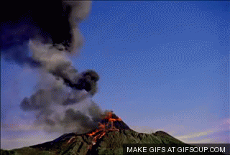
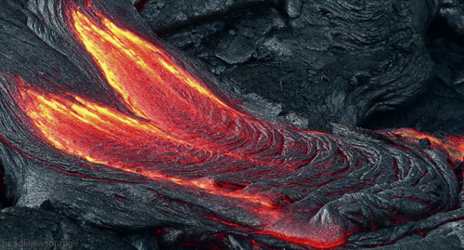
Tokykeq[khaps Ádkj
1- tkx`r Tokykeq[kh (Active Volcanoes)
¶;qft;kek ¼tiku½
LVªkWEcksyh ¼fyIikjh csVs½
esjkih ioZr ¼tkok csVs½
ekmaV dkes:u ¼vkfÝdk½

Slide 30
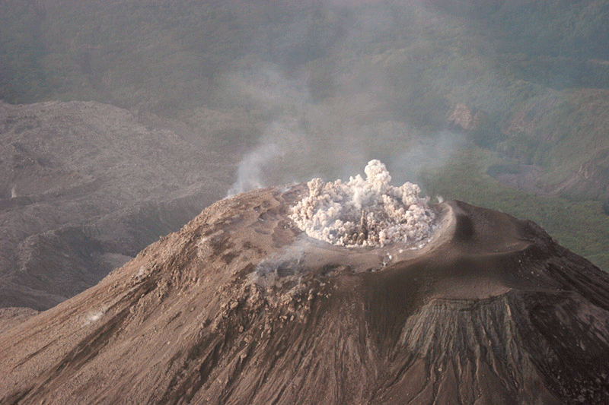
Tokykeq[khaps Ádkj
2- fufæLr Tokykeq[kh (Dormant Volcanoes)
OgslqfOg;l & bVyh

Slide 31
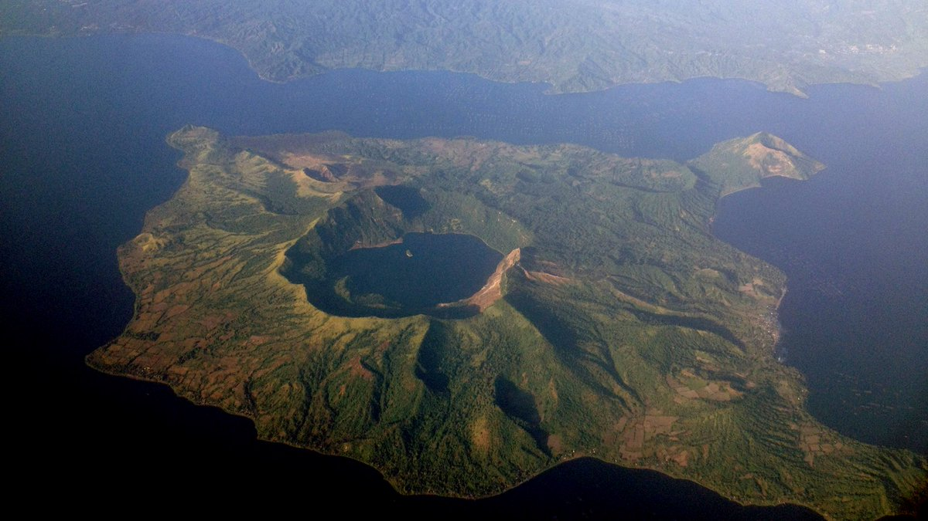
Tokykeq[khaps Ádkj
3- e`r Tokykeq[kh (Extinct Volcanoes)
vkfÝdsrhy ekmaV dsfu;k o ekmaV fdfyekatkjks
iWflfQd egklkxjkrhy lsaV gsfyuk] eksukyksok] fdykÅ

Slide 32
Tokykeq[khps ifj.kke
fo/oald ifj.kke
Tokykeq[khaP;k mæsdkeqGs thohr o foRr gkuh eksBÓk Áek.kkr gksrs-
dkgh osGk f’kykjlkjP;k ÁapM nkckeqGs Tokykeq[khP;k eq[; HksxsP;k lHkksorkyh Hkwi`"Bkyk vusd Hksxk iMrkr- ;k Hksxkauk Tokykeq[kh; Hksxk vls Eg.krkr-
f'kykjlkps lap;u unh ik=kr >kY;kl dkgh osGk unhP;k njhP;k fBdk.kh map Hkkx fuekZ.k gksrks- unhps Áokg ekxZ cnyrkr-
f'kykjl] /kwG vktwcktwP;k ‘ksrh {ks=kr il:u ‘ksrtfeuhps uqdlku gksrs-
okgrqd o nG.koG.k O;oLFkk dksyeMrs-
taxys ouLirh u"V gksrkr] ouLirhauk vkxh ykxrkr-
Tokykeq[khP;k mæsdkrwu ckgsj iMysys ok;w] /kwj] /kwG] jk[k ;keqGs gosps Ánq"k.k eksBÓk Áek.kkoj gksrs-
lkxjrGkr gks.kkÚ;k Tokykeq[khaeqGs lkxjh ouLirh o typj e`R;weq[kh iMrkr-
HkwfeLo:ikr cny gksrkr] dkgh HkwLo:is u"V gksrkr-

Slide 33
Tokykeq[khps ifj.kke
fo/kk;d ifj.kke
e`r Tokykeq[khaP;k eq[kktoG ik.kh lkpwu ljksojkaph fufeZrh gksrs- mnk- ØsVj ysd ¼la;qDr laLFkkus½
Tokykeq[khaP;k mæsdkeqGs dkgh fBdk.kh HkwxHkkZrhy xje ik.kh Hkwi`"Bkoj ;sÅu xje ik.;kps >js fuekZ.k gksrkr-
Tokykeq[khaP;k mæsdkuarj HkwxHkkZrhy xje ik.kh dkjaT;klkj[ks oj mMrs R;kl m".kksndkps Qokjs vls Eg.krkr-
i`FohP;k varxZr Hkkxkrhy Lo:i let.;kl enr gksrs-
f'kykjlkP;k lapukeqGs dkgh osGk lqfid tfeuhph fufeZrh gksrs-
HkwxHkkZrhy vusd [kfutæO;s ckgsj iMrkr-
Tokykeq[kh; csVkaph fufeZrh gksrs-
uohu i;ZVu LFkGs mn;kl ;srkr-

Slide 34
Tokykeq[khaps tkxfrd forj.k
1- iWflfQd iêk (Pacific Belt)
txkrhy 2@3 Tokykeq[kh
^iWflfQdps vXuhdad.k*
mRrj o nf{k.k vesfjdspk if’pe fdukjk] D;qjkbZy csVs] baMksusf’k;k] U;w>hyaM] b- fBdk.kkapk rj gwM] ‘kkLrk] jsuh;j] ¶;qft;kek] b- Tokykeq[khapk

Slide 35
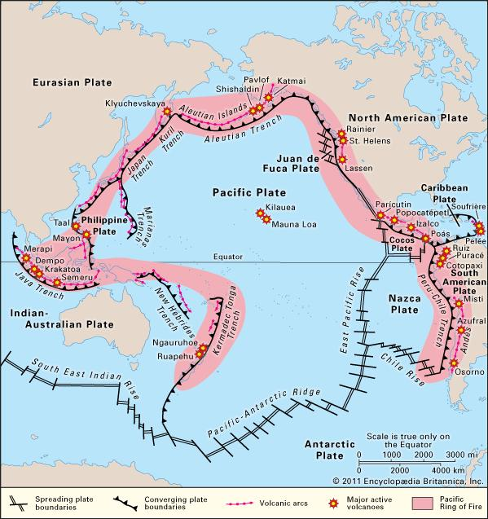

Slide 36
Tokykeq[khaps tkxfrd forj.k
2- ;qjsf’k;u iêk (Eurasian Belt)
;qjksi o vkf’k;k [kaMkrhy ?kMhP;k ioZrkanjE;kupk
dkWdsf’k;k] vkesZfu;k] bjk.k o cyqfpLrku ;k Áns’kkapk lekos’k
ØkdkVksvk] ,ycq>Z] OgslqfOg;l] LVªkWEcksyh] nseoan] b- Tokykeq[kh

Slide 38
Tokykeq[khaps tkxfrd forj.k
3- vVykafVd iêk (Atlantic Belt)
osLV baMht o vVykafVd egklkxjkP;k iwoZ Hkkxkrhy vkbZlyW.M iklwu lsaV gsysuki;Zar loZ csVkapk lekos’k
iWflfQd iêÓkpkp ,d Hkkx
e`r Tokykeq[khaph la[;k tkLr

Slide 40
c½ Hkwdai (Earthquake)
Hkwi`"Bkojhy fdaok HkwxHkkZrhy [kMdkaP;k xq:Rokd"kZ.kh; larqyukr fc?kkM >kY;keqGs Hkwi`"B daik;eku gksrs R;kl ^Hkwdai* vls Eg.krkr- & olsZVj
uSlfxZd dkj.kkaeqGs HkwvarxZr ‘kDrh dk;Zjr gksÅu T;k gkypkyh fuekZ.k gksrkr] R;keqGs Hkwi`"Bkyk gknjs clrkr R;kyk ^Hkwdai* vls Eg.krkr- & MCY;w- th- ewj

Slide 41
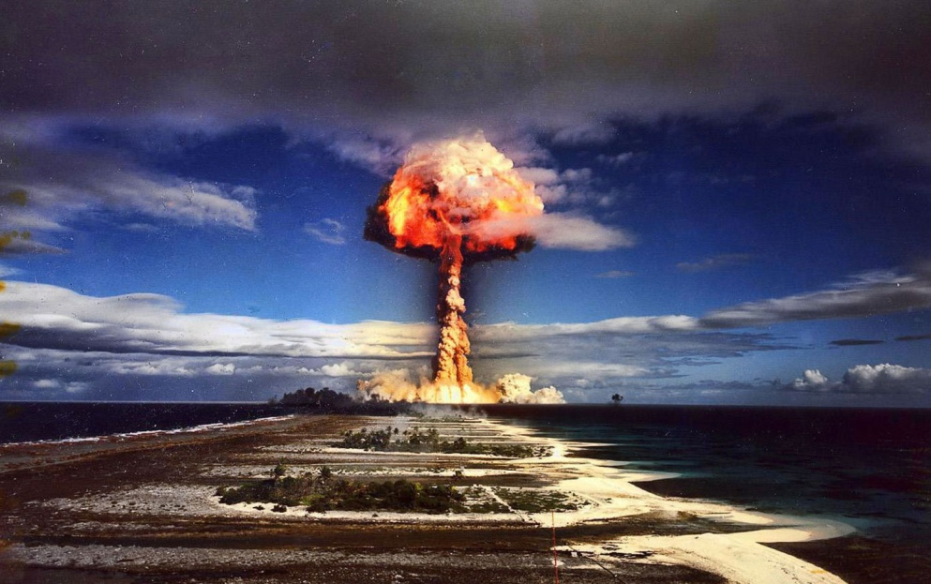
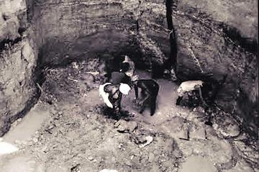
Hkwdaikps Ádkj
1- ekuofufeZr Hkwdai (Manmade Earthquake)
v.kw pkp.;k
Hkwlq#axkps LQksV

Slide 42
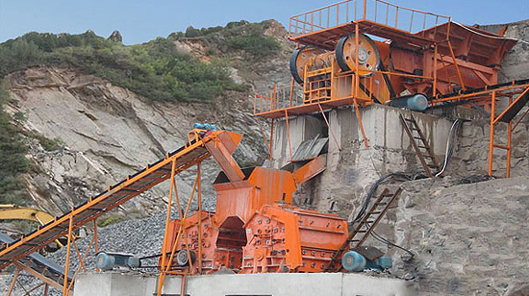
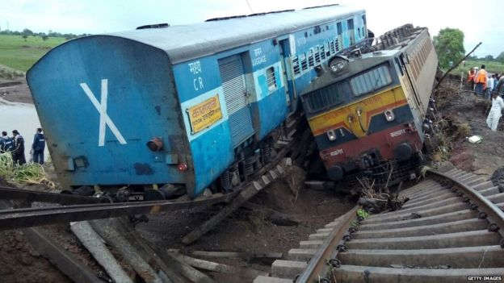
LVksu dz’klZ
jsYos] ekyxkMh vi?kkr

Slide 43
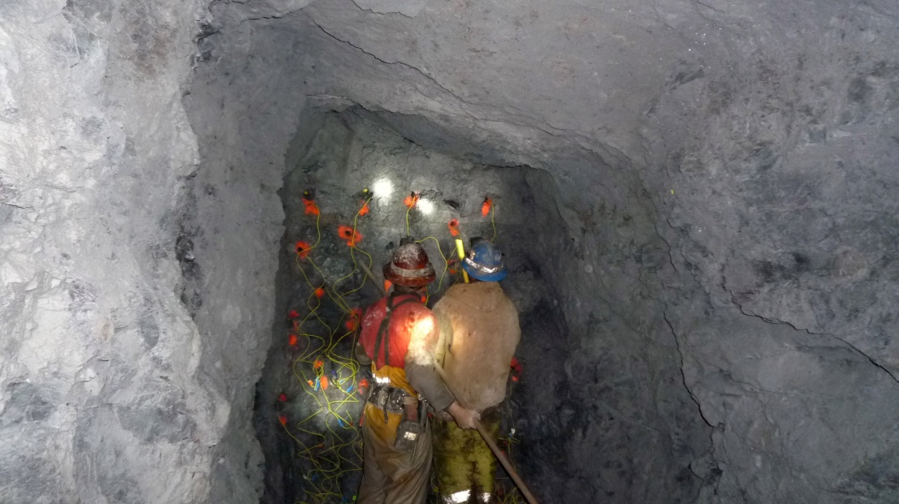
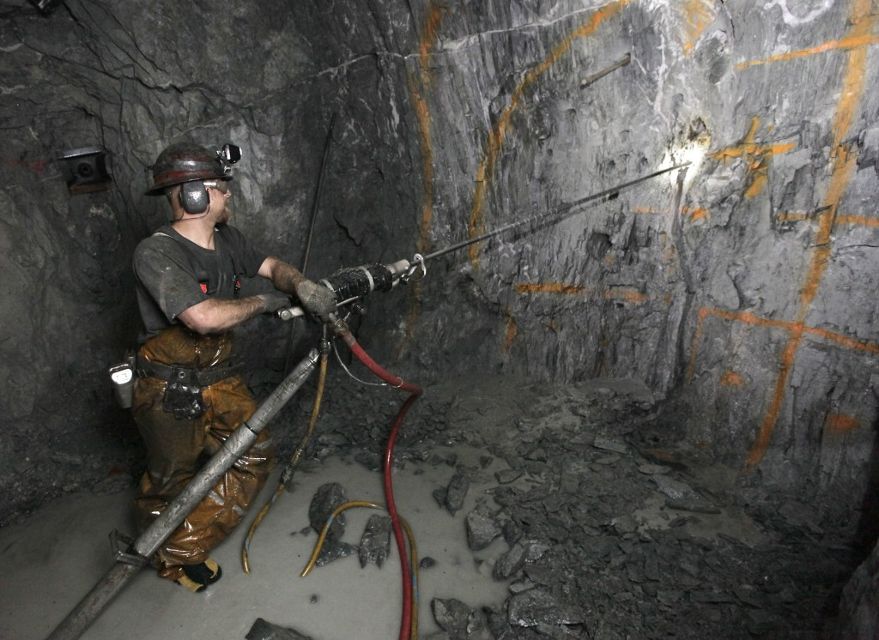
[kk.kdke
[kk.kdke

Slide 44
2- uSlfxZd Hkwdai (Natural Earthquake)
fulxZr% HkwxHkkZr gks.kkÚ;k varxZr gkypkyheqGs ts Hkwdai gksrkr R;k Hkwdaikauk ^uSlfxZd Hkwdai* Eg.krkr-

Slide 45
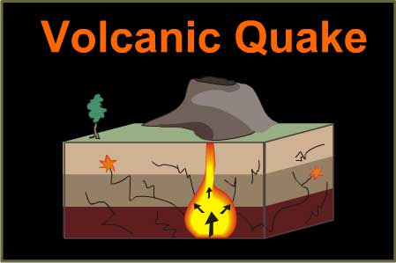
uSlfxZd Hkwdaikph dkj.ks
1- Tokykeq[khaps mæsd
^Tokykeq[kh; Hkwdai*
(Volcanic Earthquake)

Slide 46
2- ÁLrjHkax
^Hkza”kewyd Hkwdai*
(Tectonic Earthquake)

Slide 47
3- iqu% LQfVdhdj.k
^ikrkfyd Hkwdai*
(Plutonic Earthquake)
4- Hkwi`"Bkps larqyu fc?kM.ks
^larqyuewyd Hkwdai*
(Isostatic Earthquake)
5- varxZr Hkkxkoj iM.kkjk nkc
Elastic Rebound Theory
6- HkwxHkkZrhy rIr ok;w

Slide 48
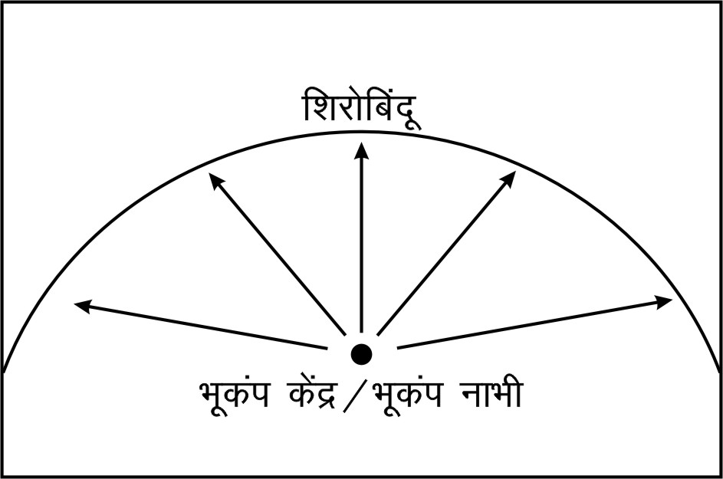
Hkwdai dsaæ @ Hkwdai ukHkh
Hkwdaikpk f’kjksfcanw @ ckádsaæ

Slide 49
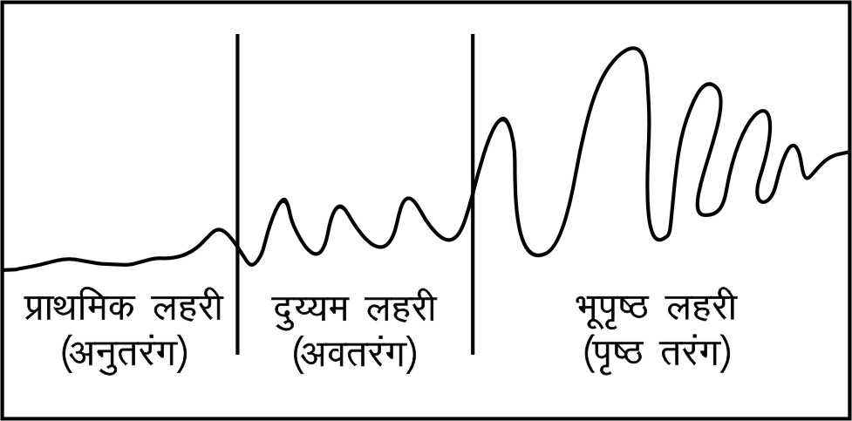
Hkwdai ygjh
1- ÁkFkfed ygjh@vuqrjax
(Primary Waves)
osx 8 rs 14 fd- eh- izfr lsdan
/ouhygjh izek.ks
;k ygjh ?ku o æo v’kk nksUgh inkFkkZP;k ek/;ekrwu Áokl d: ‘kdrkr-
?ku inkFkkZrwu Áokl djrkuk ;kapk osx tkLr vlrks-

Slide 50
Hkwdai ygjh
2- nq¸;e ygjh@vorjax
(Secondary Waves)
osx 4 rs 6 fd- eh- izfr lsdan
izdk‘kygjh izek.ks
;k ygjh QDr ?ku inkFkkZP;k ek/;ekrwu Áokl d: ‘kdrkr-
?ku inkFkkZrwu Áokl djrkuk ;kapk osx tkLr vlrks-

Slide 51
Hkwdai ygjh
3- Hkwi`”B ygjh@i`”Brjax
(Surface Waves)
osx lk/kkj.k 3 fd- eh- izfr lsdan
ÁkFkfed o nq¸;e ygjh f”kjksfcanw toG iksgpY;koj ;k ygjhaph fufeZrh
Hkwi`"Bkyk lekarj Áokl djrkr
lokZr fo/olad

Slide 52
Hkwdaikps ifj.kke
fo/oald ifj.kke
thohr o foRr gkuh
ÁLrjHkax
njMh dkslG.ks] Hkwfeikr
u|kaps Áokg ekxZ cnyrkr
okgrqd o nG.koG.k O;oLFkk dksyeMrs
oht iqjoBk [kaMhr gksrks- ohtsP;k rkjk rqVwu vkxh ykxrkr-
u|kaoj cka/kysyh /kj.ks QqVrkr- R;keqGs egkiwj ;srkr-
?kjs] bekjrhauk Hksxk iMrkr] R;kaph iM>M gksrs- yksd cs?kj gksrkr-
Tkhorhgkuh >kY;koj Ásrs dqtwu vusd Ádkjps jksx iljrkr-
Hkwty ikrGh [kkykors-
Rlqukeh

Slide 53
Hkwdaikps ifj.kke
fo/kk;d ifj.kke
tfeuhpk foLr`r Hkkx [kkyh [kpwu R;kfBdk.kh ljksojkaph fufeZrh
unhP;k ÁokgekxkZrhy HkwHkkx [kkyh [kpY;kus ufou /kc/kC;kaph fufeZrh
dkgh osGk Hkwty ikrGhr ok< gksrs
HkwxHkkZrhy [kfuts Hkwi`"Bkoj ;srkr
dkgh fBdk.kh xje ik.;kps >js fuekZ.k gksrkr
leqæ fdukÚ;kyxrpk [kkMÓkaph fufeZrh gksrs- R;k fBdk.kh canjkapk fodkl
u|kauh vkiys ik= cnyY;keqGs ufou ‘ksrh;ksX; lqfid tehu r;kj gksrs

Slide 54
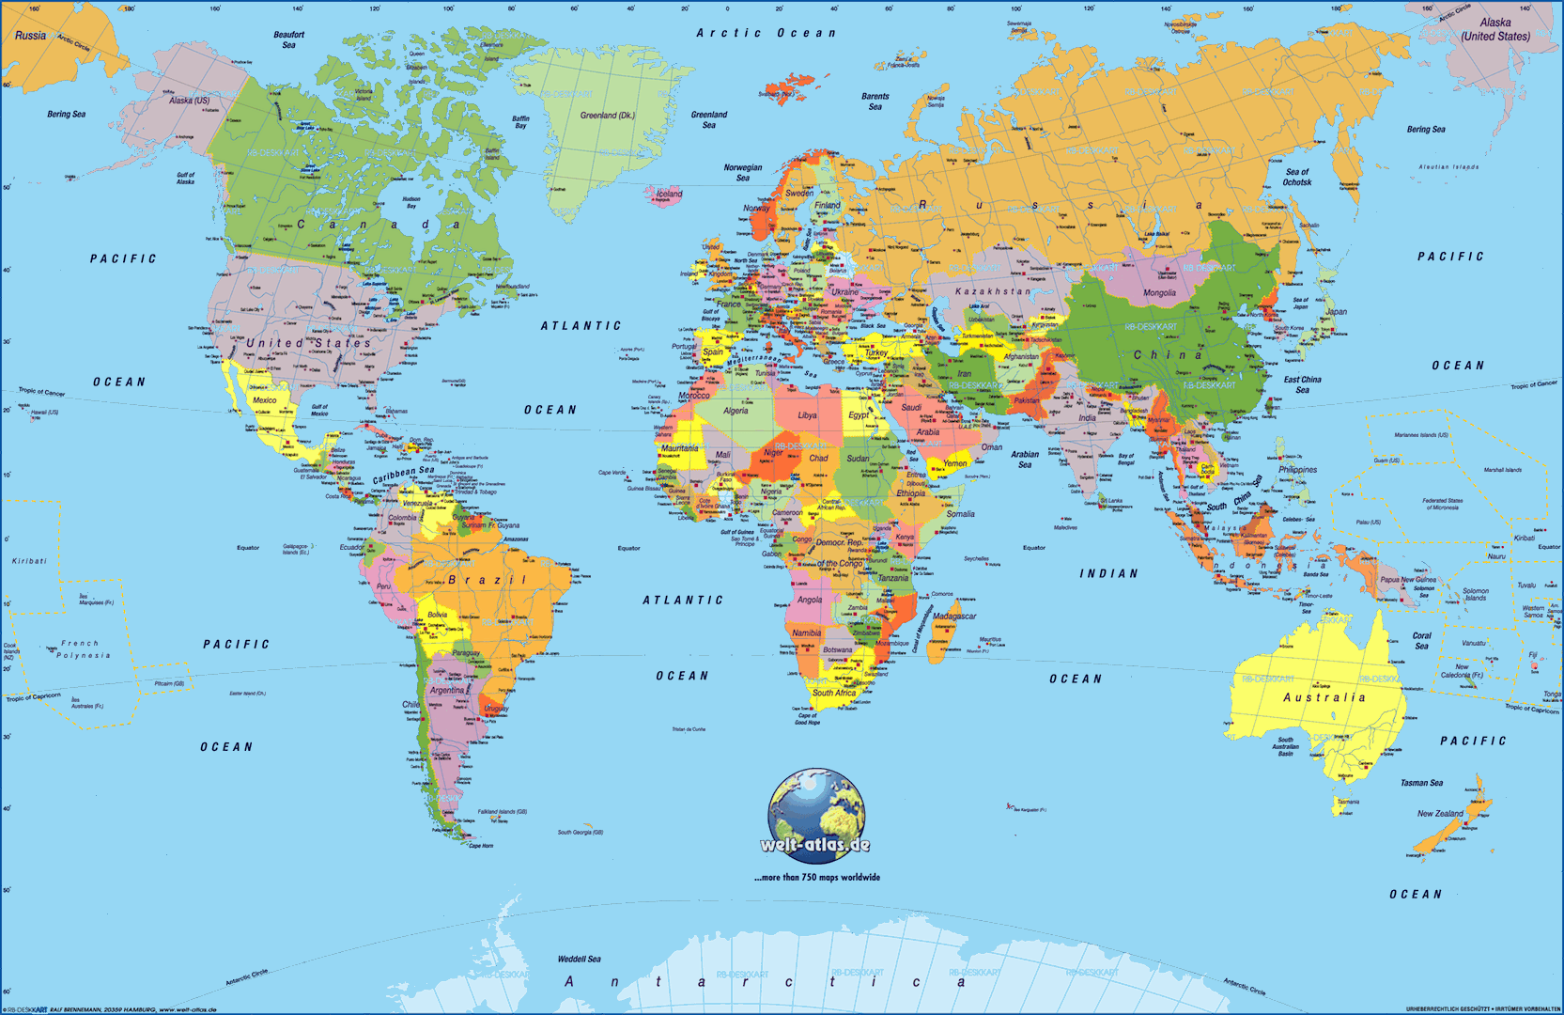
Hkwdaikps tkxfrd forj.k
1- iWflfQd iêk
lScsfj;k
tiku
dWfyQksfuZ;k
osLVbafMt csVs
esfDldks
fQfyikbZUl
U;wfxuh
is:
fpyh
U;wf>yaM
vaVkfDVZdk [kaM & iwoZ Hkkx

Slide 55
vkYil~ o fgeky; ufou ?kMhP;k ioZrkanjE;kupk Áns’kkpk lekos’k
2- e/; Hkw[kaMh; iêk
nf{k.k ;qjksi
cyqfpLrku
bjk.k
Hkkjr
vQxkf.kLrku
E;kuekj
baMksusf’k;k

Slide 56
vkYil~ o fgeky; ufou ?kMhP;k ioZrkanjE;kupk Áns’kkpk lekos’k
3- iwoZ vkfQzdspk iêk
] rs
lqos> dkyO;kiklwu
bfFkvksfi;k
;qxkaMk
Vka>kfu;k
]]] U;klk ljksoj
fMykxksok [kkMh

