Slide 1
B. Sc.I Sem.I Mathematics DSC-6A Calculus
Unit- 1 Mean Value Theorem and Indeterminate Forms

Slide 2
Mean Value Theorem
Introduction- If a function f(x)is defined over an interval [a,b]. Let c ∈ [a,b] and if the function f has a special property at c, then c is called mean value and the property is known as mean value theorem.
In this unit we see three mean value theorems.
Intervals – A number x is said to belongs to
i) a closed interval [a,b], if a ≤ x ≤ b.
ii) an open interval (a,b), a < x < b.

Slide 3
Rolle’s theorem- If function f(x) is i) continuous in closed interval [a,b] ii) differentiable in the open interval (a,b) and iii) f(a) = f(b) then there exist at least one value c ∈ (a,b) such that f’(c) = 0.
Proof- Since, f is continuous [a,b]. Hence, f is bounded in [a,b] and so it attains its bounds.
Let M be a least upper bound and m be greatest lower bound of f in [a,b].
Case I- Let M= m, then f(x)= M= m, for every x ∈ (a,b).
This means that f(x) is a constant function in (a,b).
∴ f’(x) = 0, ∀ x ∈ (a,b)
at each point c ∈ (a,b), we have,
f’(c) = 0
Hence, in this case theorem is true.

Slide 4
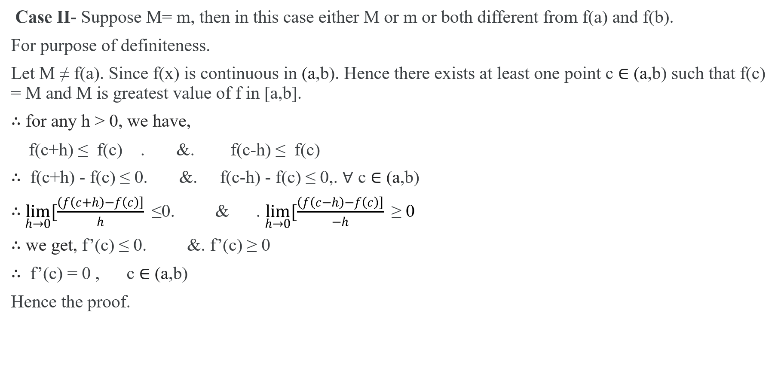
Case II- Suppose M= m, then in this case either M or m or both different from f(a) and f(b).
For purpose of definiteness.
Let M ≠ f(a). Since f(x) is continuous in (a,b). Hence there exists at least one point c ∈ (a,b) such that f(c) = M and M is greatest value of f in [a,b].
∴ for any h > 0, we have,
f(c+h) ≤ f(c) . &. f(c-h) ≤ f(c)
∴ f(c+h) - f(c) ≤ 0. &. f(c-h) - f(c) ≤ 0,. ∀ c ∈ (a,b)
∴$\lim_{h→0}{[\frac{\left(f\left(c+h\right)−f\left(c\right)\right]}{h} }$≤0. & . $\lim_{h→0}{[\frac{\left(f\left(c−h\right)−f\left(c\right)\right]}{−h} }$≥ 0
∴ we get, f’(c) ≤ 0. &. f’(c) ≥ 0
∴ f’(c) = 0 , c ∈ (a,b)
Hence the proof.

Slide 5
Lagrange Mean Value Theorem- If function f(x) is i) continuous in closed interval [a,b] ii) differentiable in the open interval (a,b) then there exist at least one value c ∈ (a,b) such that

Slide 6
Cauchy’s Mean Value Theorem- If function f(x) is i) continuous in closed interval [a,b] ii) differentiable in the open interval (a,b) iii) g’(x) ≠ 0, ∀ x ∈ (a,b) then there exist at least one value c ∈ (a,b) such that

Slide 7
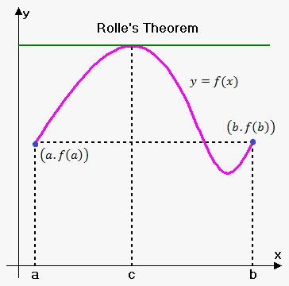
Geometrical Interpretation of Rolle’s Theorem
In the given graph, the curve y = f(x) is continuous between x =a and x = b and at every point, within the interval, it is possible to draw a tangent and ordinates corresponding to the abscissa and are equal then there exists at least one tangent to the curve which is parallel to the x-axis.

Slide 8
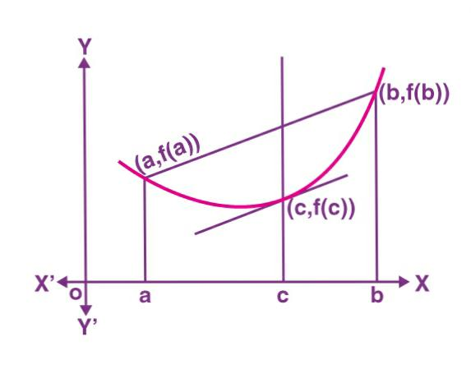
Geometrical Interpretation of Lagrange’s mean value Theorem
In the given graph the curve y = f(x) is continuous from x = a and x = b and differentiable within the closed interval [a,b] then according to Lagrange’s mean value theorem, for any function that is continuous on [a, b] and differentiable on (a, b) then there exists some c in the interval (a, b) such that the secant joining the endpoints of the interval [a, b] is parallel to the tangent at c.

